Slide 1
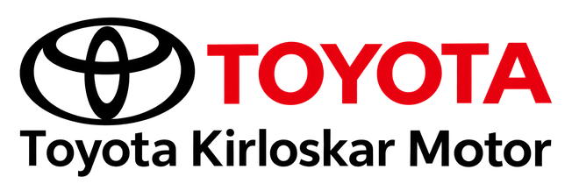

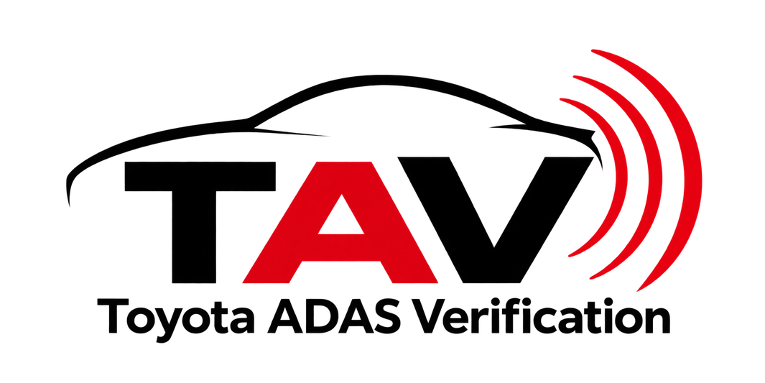
TAV
Toyota ADAS Verification
ADAS Fault Recovery, Health Verification & Maintenance
Technical Project + Innovation Proposal

Slide 2
01 / Problem Statement
What Happens When an ADAS Sensor Drifts?
A vehicle may operate normally initially, but an ADAS camera can develop calibration drift due to vibration, mount movement, thermal effects or aging.
NORMAL
ADAS operating normally
Camera yaw = 0°
DRIFT
Camera calibration error develops
IMPACT
Incorrect sensor geometry can affect perception
NEED
Detect and manage the fault without immediately abandoning the ADAS function
Detect the fault before it becomes an unmanaged ADAS condition.

Slide 3
02 / REQUIREMENTS
What Must TAV Demonstrate?
Function + Quality
FUNCTIONAL REQUIREMENTS
DETECT
Identify camera yaw fault
ESTIMATE
Measure fault magnitude
COMPENSATE
Apply inverse software correction
RECOVER
Effective yaw
→ 0°
RECORD
Fault + severity + recovery state
NOTIFY
Trigger maintenance action
SYSTEM REQUIREMENTS
  Safe fault injection
  Repeatable testing
  Modular architecture
  Real-time fault communication
  Traceable event recording
  Automated maintenance notification
Repeatable • Traceable • Modular • Explainable

Slide 4
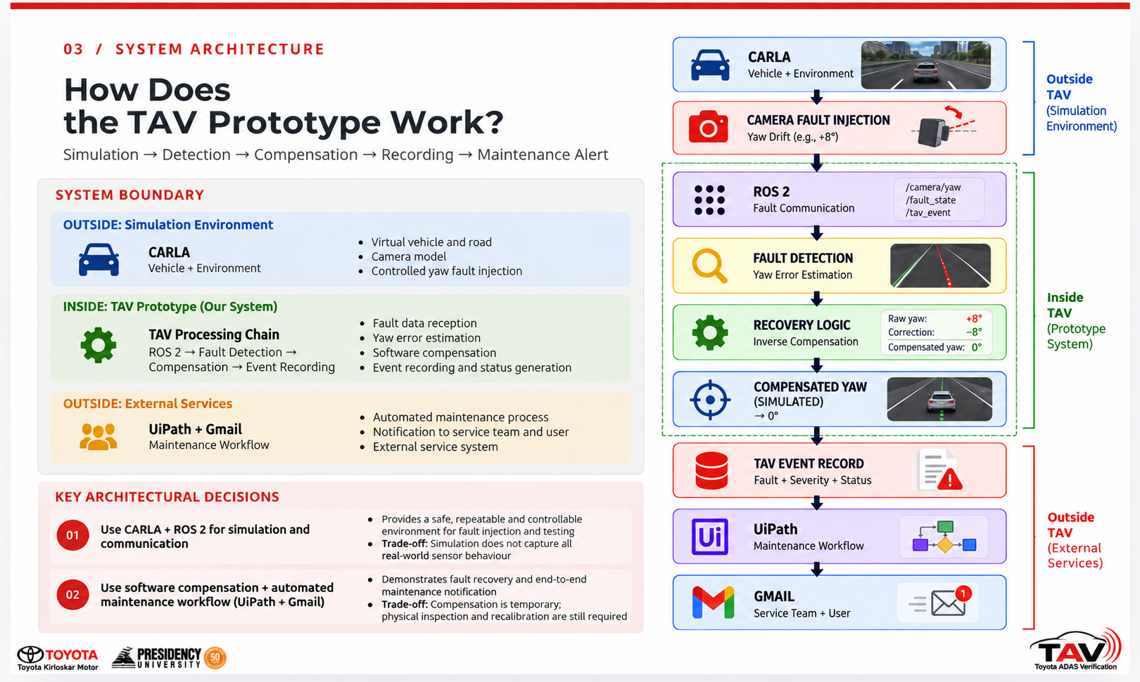
03 / SYSTEM ARCHITECTURE
How Does
the TAV Prototype Work?
Simulation → Fault → Recovery → Maintenance
System Boundary
OUTSIDE: Simulation Environment
CARLA
Vehicle + Enviornment
INSIDE : TAV Prototype (Our System)
TAV Processing Chain
ROS 2 , FAULT DETECTION , RECOVERY LOGIC, COMPENSATION
OUTSIDE TAV: External Services
TAV Event Record + UiPath + Gmail
Maintance Workflow
Notes:
This is the architecture implemented in our prototype. we will now demonstrate this flow in simulation.

Slide 5
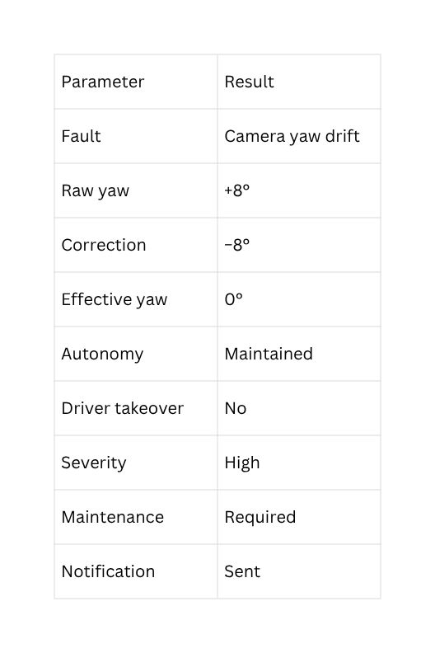
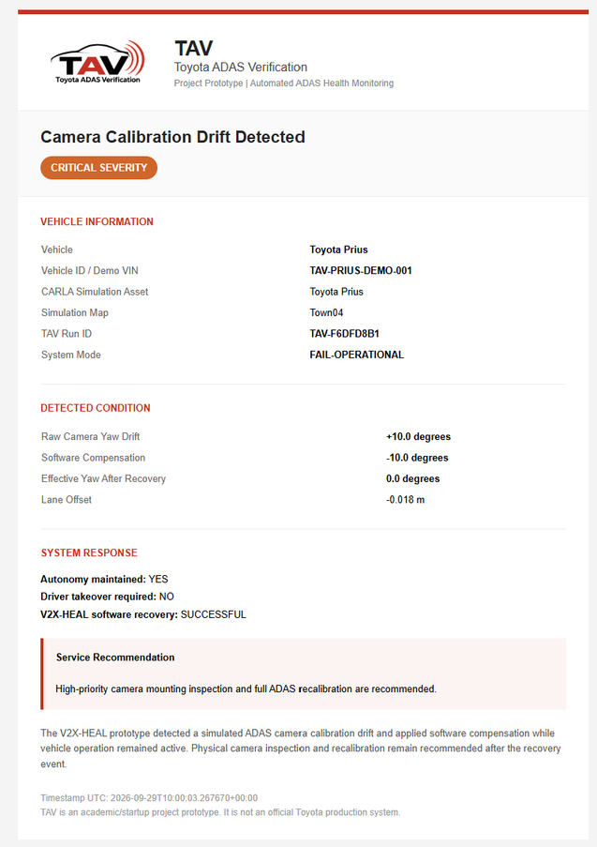
04 / RESULTS
What did the prototype demonstrate?
Fault detected
software recovery successful
autonomy maintained
maintenance alert generated
The prototype demonstrates controlled fault injection, fault detection, software compensation, event recording and automated maintenance notification in a simulated environment.

Slide 6
05 / PRODUCT EXPANSION
What Is the TAV Product?
An ADAS fault can be detected and temporarily managed — but the vehicle still needs verification and maintenance.
FAULT
ADAS camera calibration drift can occur during vehicle operation.
RECOVERY
The technical prototype detects the drift and applies software compensation.
This is still TAV.
We're simply moving from:
“TAV as a technical demonstration”
to
“TAV as a deployable product/startup.”
MAINTENANCE
The physical sensor condition still requires inspection
/recalibration.
INSIGHT
ADAS health cannot be treated as a one-time check.
This creates the need for a continuous ADAS health verification lifecycle.

Slide 7
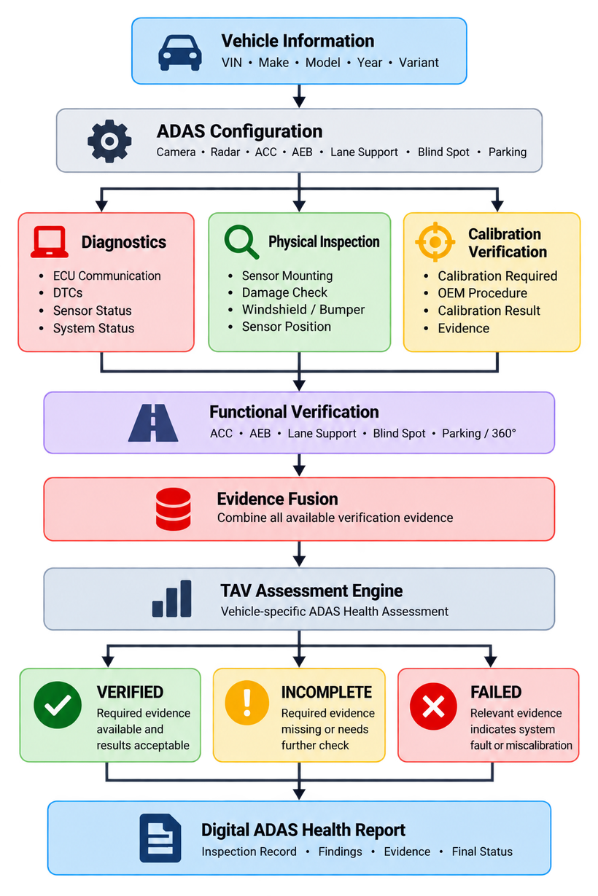
06 / CONCEPT
How TAV work as a Product?
Introducing TAV for pre-owned ADAS verification
TAV converts ADAS inspection evidence
into a vehicle-specific health assessment.

Slide 8
07 / Current Market → What TAV Adds
What Exists Today — And What TAV Adds
CURRENT USED-CAR MARKET
TAV ADDS
  General vehicle inspection
  Mechanical & body condition
  Service / vehicle history
  Existing used-car certification
  ADAS-specific verification is not always part of the standard inspection
  ADAS system identification
  Diagnostic evidence
  Physical sensor inspection
  Calibration verification
  Functional verification
  Evidence fusion
  Vehicle-specific ADAS health assessment
TAV adds a dedicated ADAS verification layer to the existing used-vehicle inspection process.

Slide 9
08 / Toyota U Trust Integration
From Vehicle Inspection to ADAS Health Assessment
Extending the existing pre-owned vehicle inspection ecosystem
TOYOTA U TRUST
TAV
ADAS Health Assessment
Digital ADAS Health Record
Exisiting Vehicle Inspection
ADAS Verification Layer
TAV adds:
  ADAS diagnostics
  Physical sensor inspection
  Calibration verification
  Functional verification
  Evidence-based assessment
TAV does not replace the existing vehicle inspection — it adds a dedicated ADAS verification layer.

Slide 10
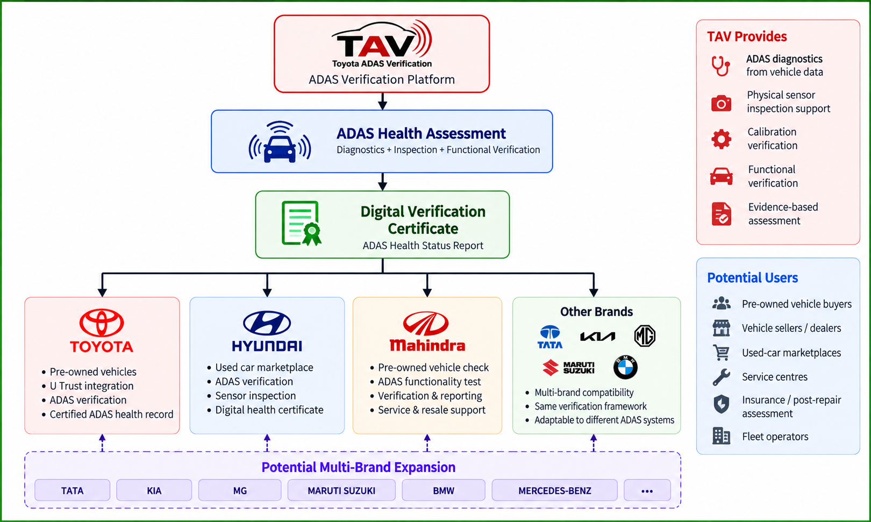
09 / Multi-Brand Opportunity
One Verification Framework. Multiple Vehicle Brands.
The same evidence-based verification framework can be adapted to different ADAS-equipped vehicle architectures.

Slide 11
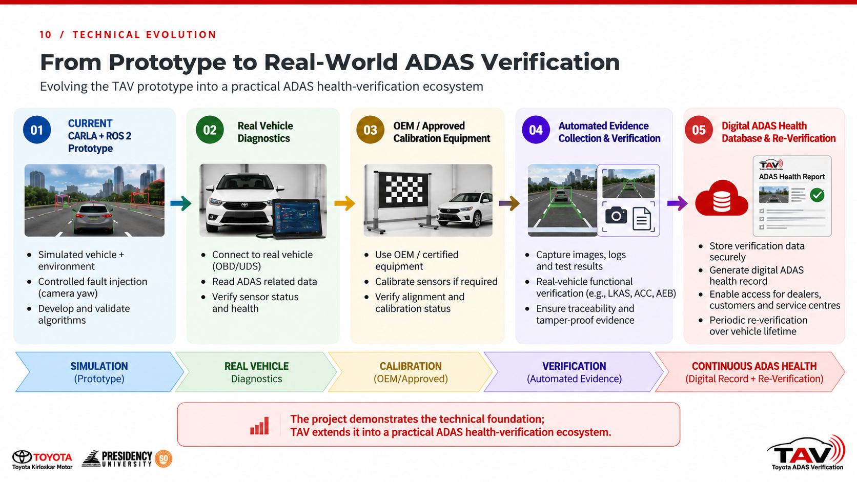
10 / Technical Evolution
From Prototype to Real-World ADAS Verification
Simulation → Real Vehicle → Service Integration → Continuous ADAS Health

Slide 12


